Slide 1

NonRetail Sector Sales Time Series Forecast
Rishabh Padore

Slide 2
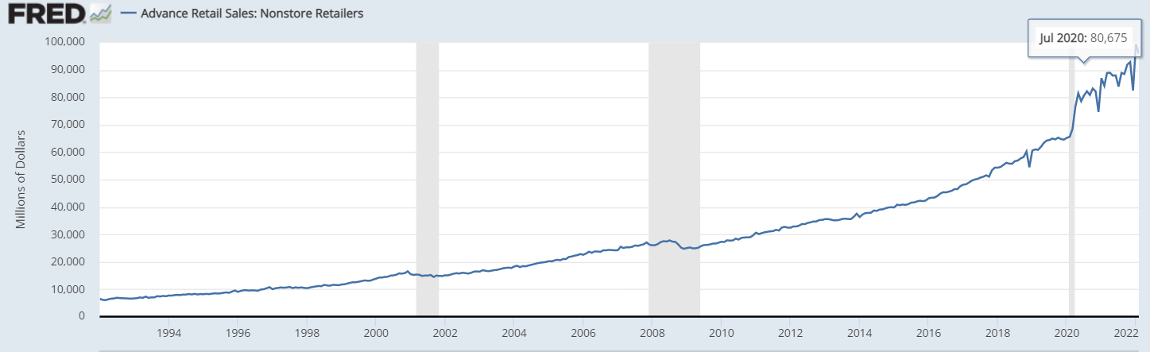
The Problem
Covid 19 had a major impact on the US Economy
Consumption was low
Relief checks were sent
Need to check the positive impacts
Non-Retail Sector boomed
Can we predict the growth of this sector using a time series model?

Slide 3



Who might care?
Federal Reserve
US Government
Big Box Retailers
Shippers

Slide 4
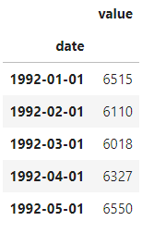
Data Information
Received data from Federal Reserve Economic Data
Date and Value column provided
Data ranges from 1992 to 2019

Slide 5
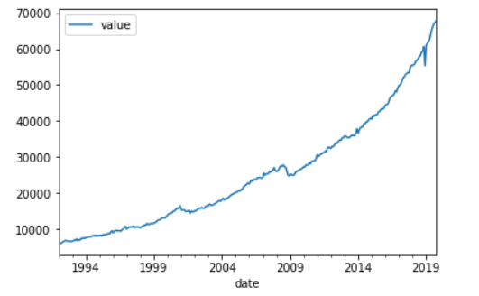
Data Exploration
We see the upward trend in nonretail sales
Data is not stationary
Minimal seasonality

Slide 6
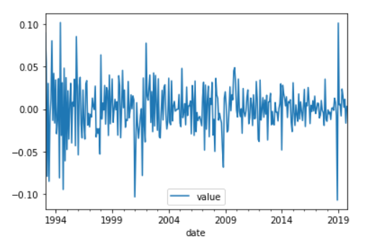
Data Preprocessing
Initial Augmented Dicky Fuller Test P values are -3.45
Needed to make data stationary
Used Pct Change and Diff
Processed AD Fuller Test Value = 6.1e-11

Slide 7
Machine Learning Module
Type: Time Series Analysis
Using ARIMA and ARIMAX models
Data needed to be made stationary
Tools: statsmodels and pmdarima
Preprocessing steps: diff, pct change

Slide 8
Algorithms used
Simple ARIMA Model
Tuned ARIMA Model
PMDARIMA seasonal automated Model

Slide 9
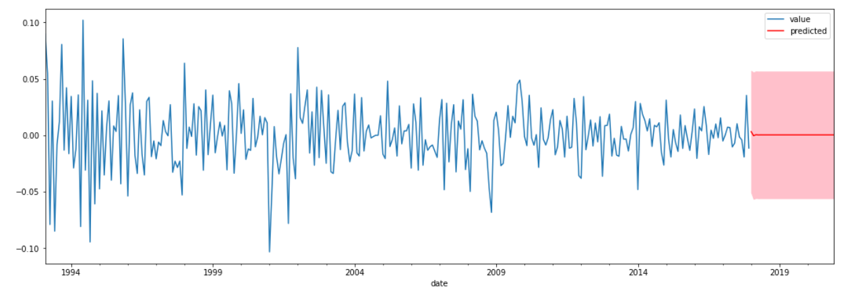
Graphical Forecast for Simple ARIMA
No real forecast
Doesn’t provide a good view

Slide 10
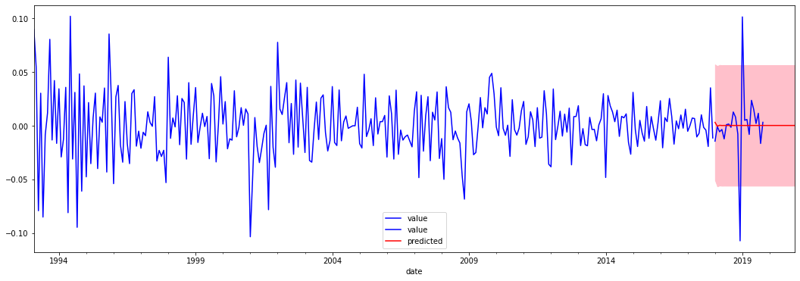
Graphical Forecast for Tuned ARIMA

Slide 11
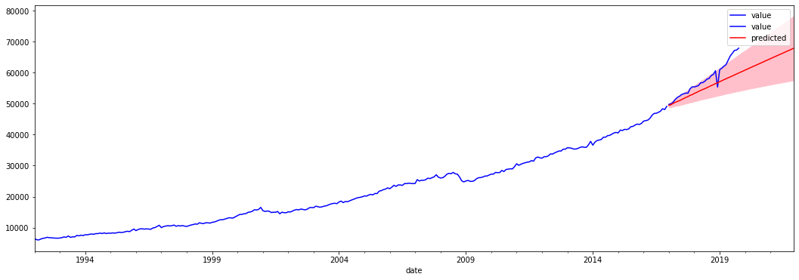
Forecast for Automated PMDARIMA

Slide 12
Assumptions, Limitations, Disclaimers
The Model is high susceptible to overfit
There is no way to predict real world occurrences
Need to allow for more factors that affect sales to be included within the model

Slide 13
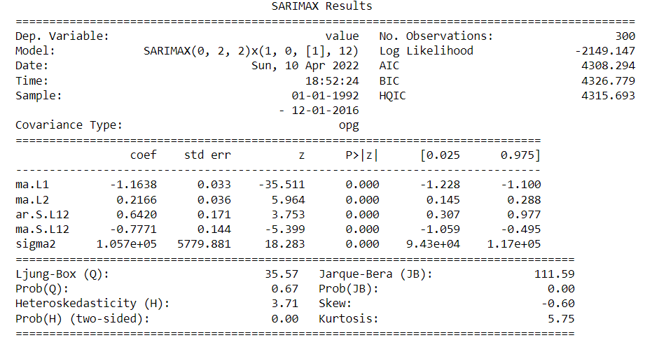
Conclusion
Overall we were able to perform a great deal of forecasting and time series analysis
Our ARIMA model performed well and was fitted correctly to the data
Features and performance can be seen to the right

